Slide 1
Ελληνική μυθολογία και τα ζώα

Slide 2
Similes
a figure of speech involving the comparison of one thing with another thing of a different kind, used to make a description more emphatic or vivid (e.g., as brave as a lion, crazy like a fox ).

Slide 3
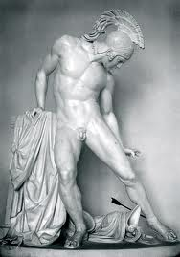
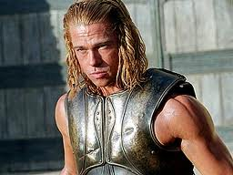
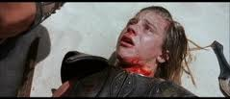
Beast Similes in the Iliad

Slide 4
Beast Similes in the Iliad, Cont.
Battle over dead Patroclus.
Menelaus stands over him like a cow protecting her calf (17.3-6).
Menelaus stands like a lion standing over a cow that it has killed (17.61-69).
Ajax defends the corpse like a lioness guarding her cubs (17.132-37).
Achilles- Lion and Wolf
Hector- Man and Sheep

Slide 5
Achilles vs. hector
http://www.youtube.com/watch?v=N8lnE8b19tw

Slide 6
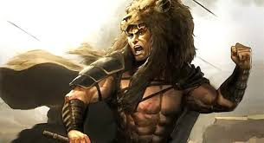
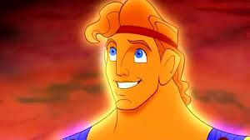
The Myth of Heracles (Hercules)

Slide 7
Back Ground of The Myth of Heracles
Step mom, Hera, hates him and tries to kill him as a child and makes him kill his own children.
Heracles has to do 12 labors for his cousin, Eurystheus, to make up for the sin.
The 12 labors were:
1. Slay the Nemean Lion.
2. Slay the nine-headed Lernaean Hydra.
3. Capture the Golden Hind of Artemis.
4. Capture the Erymanthian Boar.
5. Clean the Augean stables in a single day.
6. Slay the Stymphalian Birds.
7. Capture the Cretan Bull.
8. Steal the Mares of Diomedes.
9. Obtain the girdle of Hippolyta, Queen of the Amazons.
10. Obtain the cattle of the monster Geryon.
11. Steal the apples of the Hesperides
12. Capture and bring back Cerberus.

Slide 8
Beast Similes in the myth of Heracles
John Berger
Humans vs. Animals
Humans over Animals?
Heracles overcoming all animals

Slide 9
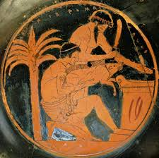
Animal Sacrifice in Greek Mythology

Slide 10
Animal Sacrifice, Cont.
Sacrificed to which God the animal they were sacrificing preferred.
Usually a domesticated animal.
Key symbol of paganism.
Berger again, Humans dominate over animals.

